Slide 1
Persuasion Techniques-Lesson I
T. Sunand Emmanuel
Assistant Professor in English, H&SS Department
Vasavi College of Engineering
Hyderbad-500031
Telangana State

Slide 2
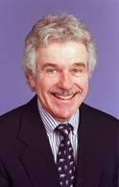
Dedicated to my teachers……
Dr. Mark L. Knapp (Ph.D., Pennsylvania State University, 1966).
He is the Jesse H. Jones Centennial Professor Emeritus of Communication and UT Distinguished Teaching Professor Emeritus at the University of Texas at Austin.

Slide 3
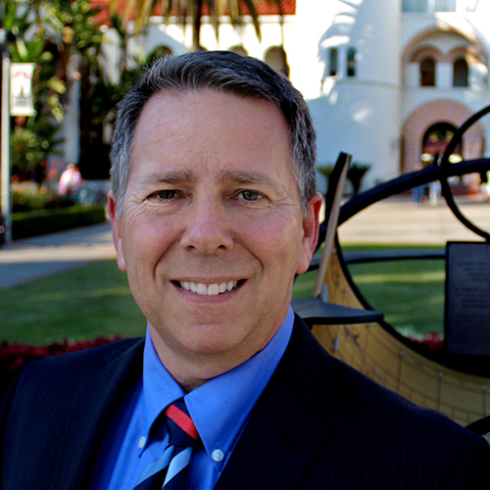
and to………..
Prof. Brian H. Spitzberg,
(Ph.D. the University of Southern California, 1981.
He is Senate Distinguished Professor Emeritus, School of Communication, San Diego State University, San Diego, CA.

Slide 4

So what is persuasion?

Slide 5
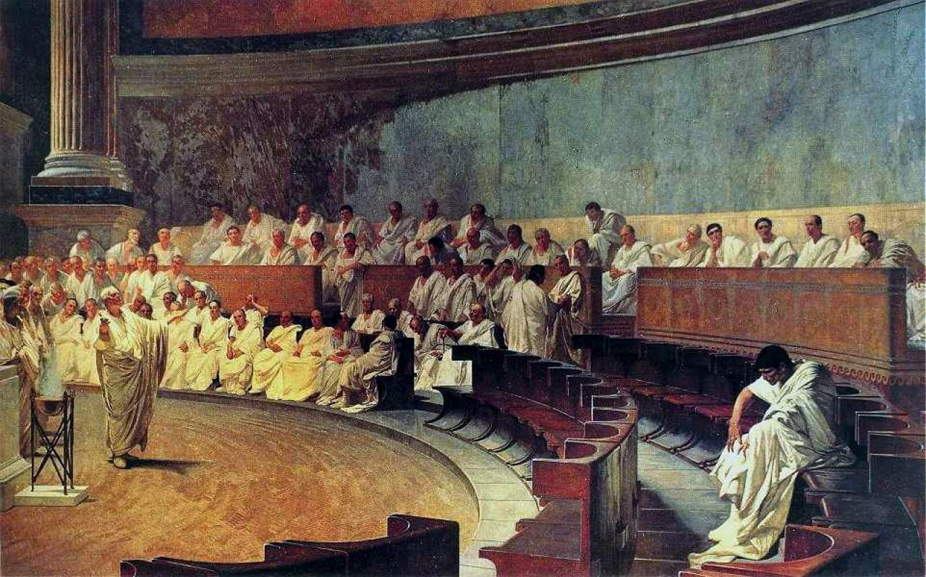

Slide 6
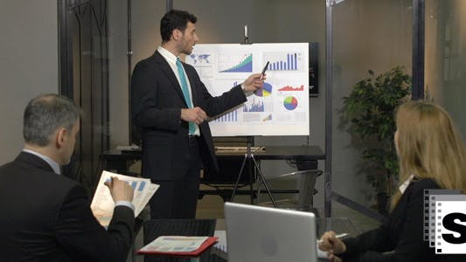

Slide 7


Slide 8
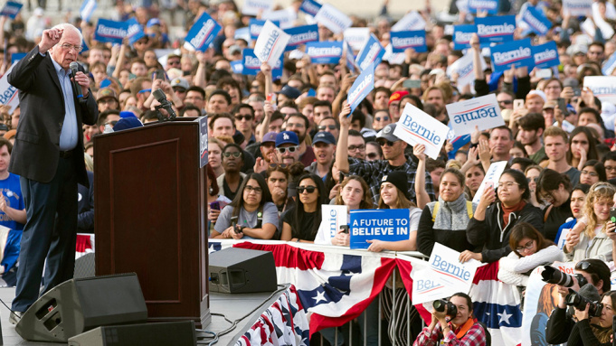

Slide 9
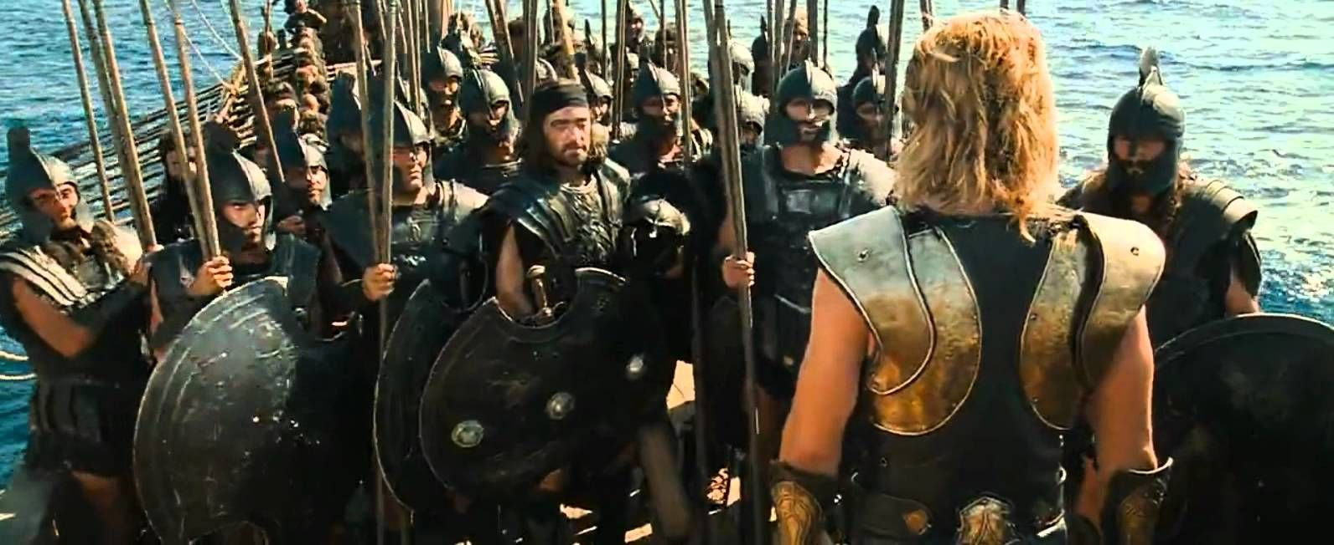
Troy Achilles Speech to Myrmidons

Slide 10
Think for a while……
When you bought a mobile phone…
when you went to buy a car along with your parents……
When you went to a hotel to order items in the menu…
When you bought a lap top…….
When you bought a i7 desktop computer….
When you bought a pair of jeans…
When you bought a perfume to impress your friend!!!

Slide 11
Think for a while……
Why did you end up buying that?
Think of the sales manager/the service provide now…..
What was special about him/her?

Slide 12
Think for a while……
His dress?
His appearance?
His tone of voice?
Command in language?
Appealing to your budget needs?
Sales manager’s knowledge of that product!
Did he also mention how many already bought that car/phone?
Did he also mention who else bought that product?
Yes all the above
Yes all the above

Slide 13
Think for a while……
Let’s say one of your relatives has recurring cervical spondylitis. He is not getting cured.
And if you know both the doctors mentioned below, whom would you recommend?
Dr. Prakash Rao, MBBS (OU)
or
Dr. Sudhakar Rao, MBBS (AIIMS), MD, DM (AIIMS) (Neurology)
???

Slide 14
Think for a while……
If you want to know about stars in the sky, movements, features?
Would you trust
An astrologer (who also claims to know about stars and their movements!)
or a
person who has a PhD in Astrophysics?
(who has dedicated his life to studying ‘stars’ for decades?
We generally would believe the PhD scientist!!!

Slide 15
Think for a while……
You want take some decision regarding some project which uses C language……
Would you believe what a polytechnic student (3 years course) who learnt C language says or what a B.E. Engineering Graduate says? (4 years course)
Generally . . . .we would trust the information given by a B.E. Engineering graduate than a polytechnic graduate!

Slide 16
Think for a while……
When it comes to steps and precautions to be taken to prevent corona virus disease, would you believe?
Advice of Religious preachers on COVID 2019? (assuming they too know about COVID…)
OR
Dr. Krishna Ella, Chairman & Managing Director of Bharat Biotech International Limited

Slide 17
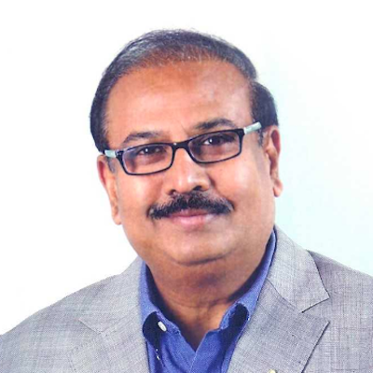
A brief profile of Dr. Krishna Ella…
M.S., University of Hawaii
Ph.D., University of Wisconsin-Madison
Established Bharat Biotech International Limited in 1997
Research scientist in Molecular Biology
https://www.bharatbiotech.com/founder-profile.html

Slide 18
His company’s achievements….
Developed and launched the world’s most affordable vaccine for Rotavirus
Developed World’s 1st clinically proven and WHO pre-qualified Typhoid Conjugate Vaccine (TCV).
Global patents for Chikungunya and Zika viruses
Crossed major milestones in the development of these vaccines.
World’s largest supplier of rabies vaccines

Slide 19
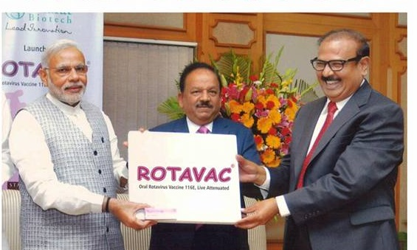
Dr. Krishna Ella receiving award from our Honorable Prime minister!

Slide 20
So how do we define Persuasion?
The use of messages to influence an audience.
The use of messages to achieve your goals.

Slide 21
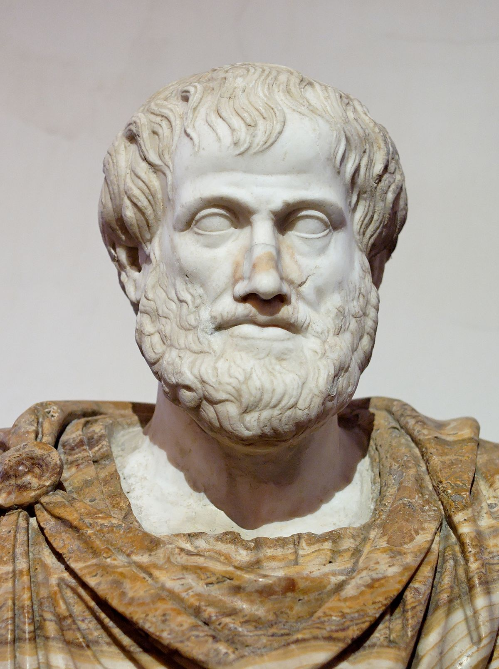
What did Aristotle say?
According to Greek philosopher Aristotle (384–322 B.C.), THREE things are required to persuade others effectively.

Slide 22
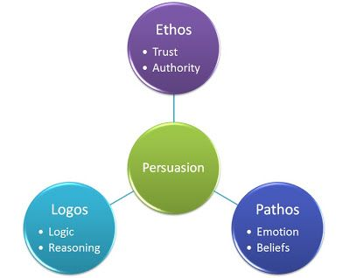

Slide 23
Ethos
Credibility (knowledge, qualifications, reading) +Character (sincerity, others’ testimonies…show that you are well-read!)
That you are intelligent and can be trusted!
Extensive research (journals, cite scientists’ names)
Up-to-date research
Recognized authorities in the field

Slide 24
Pathos
Emotional appeals.
For example, you want to raise funds for an orphanage. Now, appeal to the audience telling them about the lives of orphan children, their hunger, problems and challenges. Make them feel for the orphan children. Create a sense of sympathy and empathy!
Fear, anger, sadness, pity, excitement.
Sad photographs, personal experiences

Slide 25
Logos
Logos means using logical arguments.
Present evidence, facts, statistics
Numerical figures
Graphs, charts to the audience.
However, do not use illogical arguments to mislead the audience!

Slide 26
Companies use persuasion in the form of advertising to convince consumers to buy their products or services.
Parents can use persuasion to get their children to study or to clean up their rooms.
Children use persuasion to convince their parents to give them pocket money. Teachers persuade students to study well by mentioning the benefits of good academic grades.

Slide 27
We persuade our friends if we want see a particular movie. People use persuasion to get their friends to go to see a certain movie, or a band, or to hang out at the mall.
Students persuade teachers to accept assignments after the due date!

Slide 28
Of course, people can also use threats to get what they want, but that is not persuasion! In persuasion, we try to convince the audience to do what we want them to do out of their own interest! People do something willingly because they believe what you are telling them is for their good!

Slide 29

“You must do it “or else”---This is not persuasion!

Slide 30
Students, parents, teachers, politicians, administrators, sales managers, and friends use persuasion in their everyday lives.
Mass media from print (newspapers, magazines, direct mailing) to electronic (radio, television, the World Wide Web) thrives (depend) on advertisements.

Slide 31
Whether it is a pay rise or promotion, or convince your manager of the value of your new ideas, you need to have the ability to persuade. At work place, persuasion is need to convince colleagues, peers and senior leaders in achieving success.

Slide 32
Yes......some people are naturally persuasive and are easily able to steer a strategy or conversation in their preferred direction.
However, many of us may not have the natural persuasive ability. Fortunately, there are a number of persuasive techniques we all can learn and improve to influence others.

Slide 33
Some common persuasive techniques are as follows: 1. The ‘framing’ method
Keep the receiver in mind while describing or explaining something. Take the classic example of a glass that is ‘half full’ or ‘half empty’ – the first phrase sounds much more positive! This technique is often used effectively by politicians.
Choose the right time, place and people to communicate with. Carefully construct your argument. Explain the advantages more than negatives. Select the most appropriate words to explain your viewpoint

Slide 34
2. Talk about ‘we’, not ‘you’
Use the word ‘we’ instead of ‘you’. Include yourself. Identify with the audience.

Slide 35
3. Be specific and confident
If you speak confidently, clearly and concisely, people are more likely to listen to you, They will listen to you seriously, and agree with you. Prepare what you want to say. Make sure you are clear in your own mind before tackling a tricky conversation.

Slide 36
4. Explain what’s in it for them
One great way of persuading people is to explain the benefits that will affect them specifically. If someone can see and appreciate that agreeing with you will offer advantages to them personally, they’ll be much more inclined to agree with you.

Slide 37
5. Create scarcity and urgency
Create a real need for something.
Think about the limited-edition products that brands launch – the fact that consumers believe they may miss the opportunity to own something new! It makes them rush out to buy them. But do not tell lies or rush people.

Slide 38
6. The ‘but you are free’ technique
Do not lie. Do not rush people. Always give a choice-- ‘but you are free’ (BYAF) technique. It will double the chances of people saying ‘yes’ to your idea.
Simply remind them that they are free to make a decision on the subject you’re discussing, and they will be more disposed to agree with you.

Slide 39
7. The ‘it’s working for others’ approach
People naturally look to others to make their decisions and influence their behaviour. For example, if most people are buying one plus 7 phone, we too may consider or buy. The reason is ‘herd effect’. Just tell them a particular service or strategy is being used by a lot of people in your industry or profession. It will make the audience/receivers think.

Slide 40
8. Get agreement on a more minor point first
Use the ‘ yes ladder’ technique. Persuade people to agree with a minor point, or to carry out a smaller task. Then, convince them to agree with a bigger project. For example, my LIC policy advisor made me take a smaller amount LIC policy (Rs.1000/-). Then, a bigger LIC policy Jeevan Anand (Rs.7000/-)!

Slide 41
9. Use data and evidence to support your cause
Collect evidence and data that supports your idea – whether that’s from academic studies, surveys, scientific reports, or research that you’ve undertaken. Then, your ideas/proposals will carry more weight.

Slide 42
10. Pay attention to your body language
Your body language also has a significant impact on your ability to persuade:
Smile – It makes you seem approachable, likeable, friendly.
Eye contact – Maintain proper eye contact to show interest in the conversation and trustworthiness.
Have open body posture-- Do not cross your legs or hands while talking.
Adapted from: https://www.ciphr.com/advice/10-persuasion-techniques-to-use-at-work/

Slide 43
THANK YOU

